Slide 1

Custom Bootcamp
Week 2 (Aug 28 – Sep 1)
Pagidala Saketh Reddy
Employee code: 655074
Unext ID: SH7B23136

Slide 2

Agenda
Day1 – Case Study
Day2 – DBMS Intro and ER diagrams
Day3 – Big Data and Hands-on with oracle SQL
Day4 – Azure SQL, SQL queries
Day5 – Joins, Sub queries with Hands on

Slide 3
Case Study
Create a Virtual Machine
Connect to it with www.ssheasy.com
Install the docker in VM
Launch Docker Desktop
Build a Java image (Spring Boot Application)
Create a repository in Docker Hub for Spring image
Create a Docker hub account and login to it from VM
Load the image into the repository
Create a CI-CD application in GitHub through workflow
Commit the changes so that image in docker hub is updated.
Create an Azure web app with image and tag and check if the app is running.

Slide 4
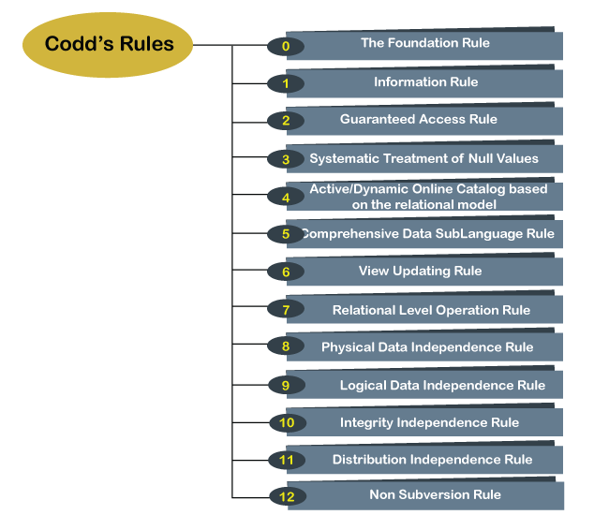
DBMS Introduction
CODD’S Rule :

Slide 5
DBMS Introduction
Attributes
Numeric
Date and time
Boolean
Character
Binary Data
Entities
Main Entity
Weak entity
Sub Entity
Associative Entity
Relationships
1:1
1:N
M:N
Normalization
1NF
2NF
3NF
4NF
BCNF

Slide 6
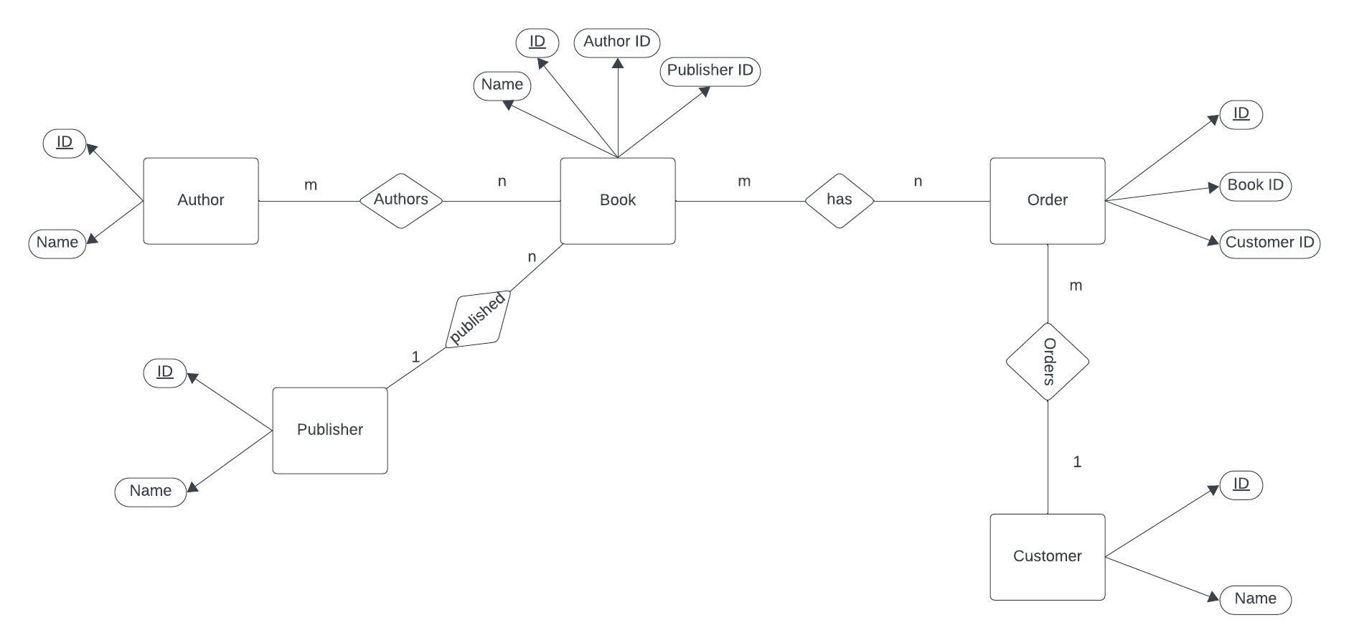
ER Diagram

Slide 7
RCD, SCD and UCD
RCD – Rapidly
It is a dimension which has attribute where values change often.
SCD – Slowly
It is a concept in data warehousing and database management that deals with managing changes to dimension data over time.
Type 1 : Only Latest state of data is maintained
UCD – Unchanging
Dimension Table
Nomenclature eg Table Employee so for dimension table name will be D_Employee or Demployee or DimEmployeee or Dim_Employee

Slide 8
BIG DATA
Big Data Terms
Volume (large amount of data)
Value
Veracity (Refers to the quality and accuracy of the data) Variety (different type of data like audio,video and IOT devices)
Velocity (Generating data very fast) Privacy: Protecting sensitive information and complying with data privacy regulations.
Security: Safeguarding data against breaches and cyber threats.
Scalability: Scaling infrastructure and systems to accommodate growing data volumes.
Complexity: Navigating the intricacies of distributed computing and data management.
Cost: Managing the expenses associated with storage and processing.
Data Integration: Integrating data from various sources for analysis.
Real-time Processing: Achieving real-time analytics and decision-making.
Data Governance: Establishing policies and practices for data management.
Talent Shortage: Finding skilled professionals in big data technologies.
Ethical Concerns: Addressing ethical dilemmas related to data collection and usage.

Slide 9
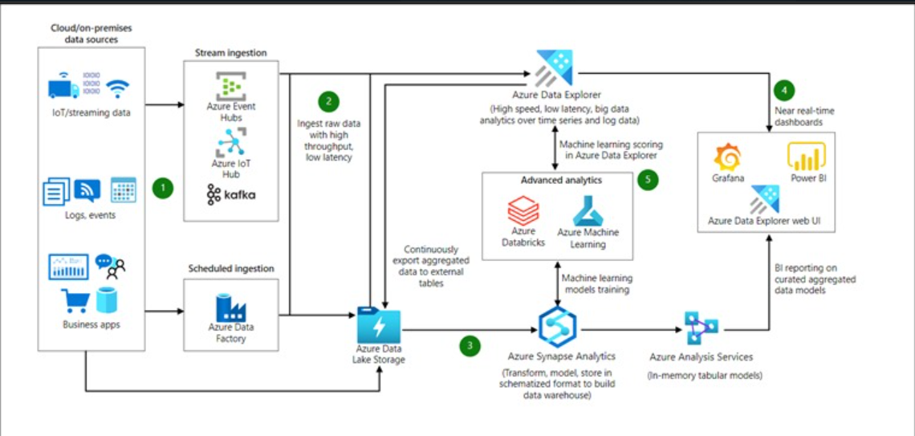
Big Data Architecture

Slide 10
HDFS (Hadoop Distributed File System)
HDFS has a master/slave architecture. An HDFS cluster consists of a single NameNode, a master server that manages the file system namespace and regulates access to files by clients.
In addition, there are several DataNodes, usually one per node in the cluster, which manage storage attached to the nodes that they run on.
HDFS exposes a file system namespace and allows user data to be stored in files. Internally, a file is split into one or more blocks and these blocks are stored in a set of DataNodes.
The NameNode executes file system namespace operations like opening, closing, and renaming files and directories. It also determines the mapping of blocks to DataNodes.
The DataNodes are responsible for serving read and write requests from the file system's clients. The DataNodes also perform block creation, deletion, and replication upon Instruction from the NameNode

Slide 11
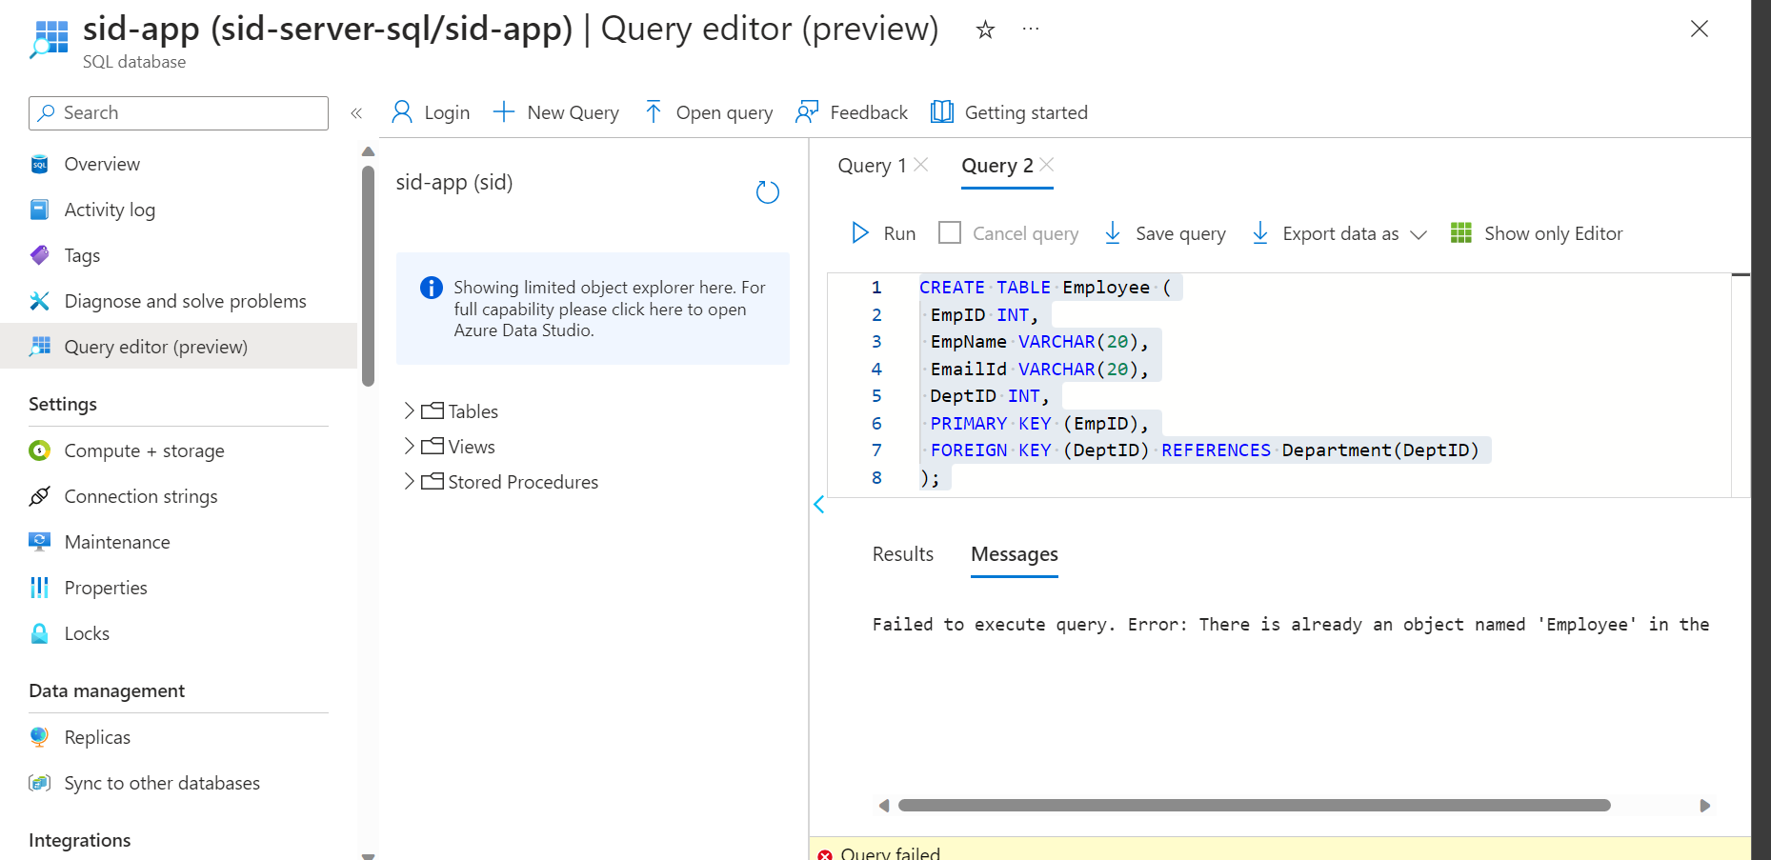
Azure SQL

Slide 12
SQL Queries
SQL Clauses:
SELECT Clause: Used to specify which columns to retrieve from a table.
FROM Clause: Specifies the table(s) from which to retrieve data.
WHERE Clause: Filters rows based on a specified condition.
GROUP BY Clause: Groups rows with identical values in specified columns into summary rows.
HAVING Clause: Filters grouped rows based on a specified condition.
ORDER BY Clause: Sorts the result set by one or more columns in ascending or descending order.

Slide 13
SQL Queries
Aggregators (Aggregate Functions):
SUM(): Calculates the sum of a numeric column.
AVG(): Calculates the average of a numeric column.
COUNT(): Counts the number of rows in a result set.
MAX(): Retrieves the maximum value from a column.
MIN(): Retrieves the minimum value from a column.
Joins:
INNER JOIN: Combines rows from two or more tables based on a related column.
LEFT JOIN (or LEFT OUTER JOIN): Retrieves all rows from the left table and matching rows from the right table.
RIGHT JOIN (or RIGHT OUTER JOIN): Retrieves all rows from the right table and matching rows from the left table.
FULL JOIN (or FULL OUTER JOIN): Retrieves all rows when there is a match in either the left or right table.

Slide 14
SQL Queries
SQL Subqueries:
Scalar Subquery: A subquery that returns a single value and is often used in the WHERE or SELECT clause to compare with other values.
Row Subquery: A subquery that returns one or more rows of data and can be used in places where a table or row expression is expected, like the FROM clause.
Table Subquery (Table Expression): A subquery that returns a result set or table, treated as a temporary table, and used in the FROM clause for complex joins and operations.
Correlated Subquery: A subquery that references values from the outer query, enabling the subquery to be evaluated for each row of the outer query.
Nested Subquery: A subquery within another subquery, allowing for multi-level nesting to achieve complex data retrieval and manipulation.

Slide 15
SQL Queries
Indexes:
Indexes improve database query performance by allowing quick data retrieval based on indexed columns.
Types include primary key, unique, clustered, non-clustered, and composite indexes.
Benefits include faster SELECT queries and data integrity enforcement.
Stored Procedures:
Stored procedures are precompiled sets of SQL statements stored in a database.
They encapsulate business logic, enhance code reusability, provide security, and improve performance by reducing repetitive SQL execution.
Useful for frequently executed tasks and complex data processing in a database.

Slide 16

Thank You

